Slide 1
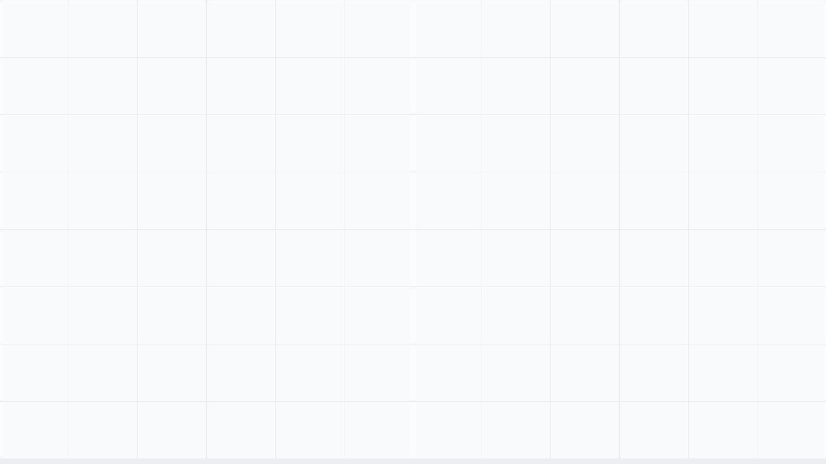
Traffic Light Controller Design
CSEN211 — AUB Mediterraneo
Adagamov Nikita & ALWaleed Hameed

Slide 2

PROJECT OVERVIEW & GOALS
[ MAIN_OBJECTIVE ]
Design a safe and efficient traffic light controller for a four-way intersection.
[ SYSTEM_GOAL ]
[ SAFETY_PRIORITY ]
[ CORE_MECHANISM ]
Error-free management of vehicle flow between North-South and East-West roads.
Focus on perfect synchronization and dedicated pedestrian protection mechanisms.
Use of a Finite State Machine (FSM) for predictable and reliable transitions.

Slide 3
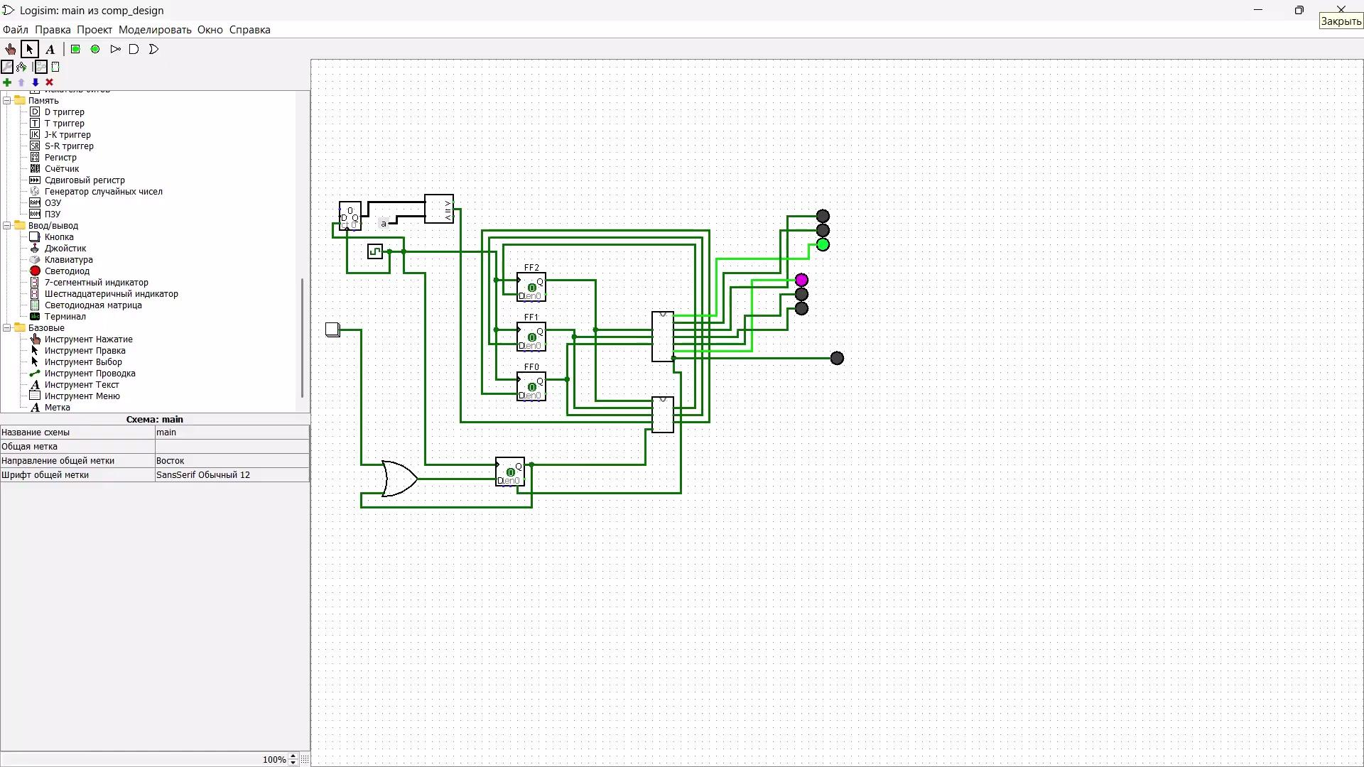

Slide 4

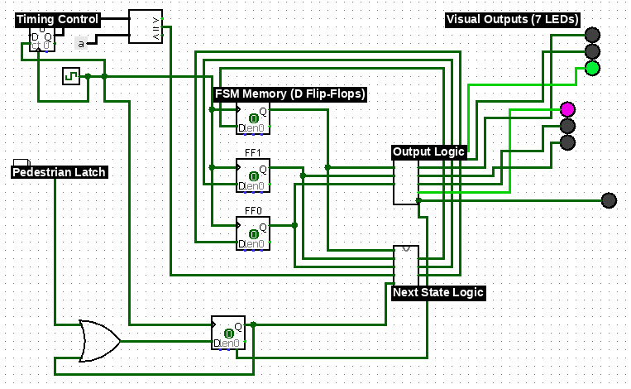
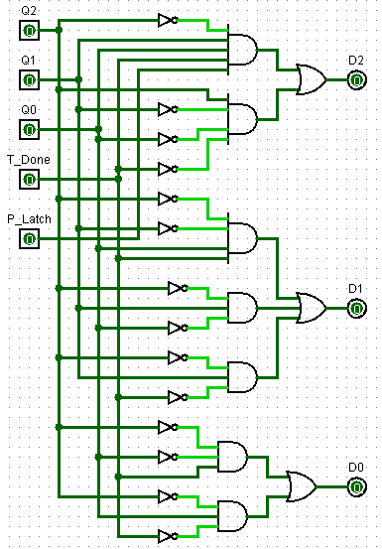
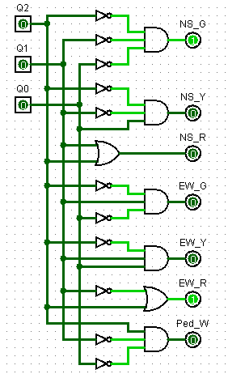
KEY DIGITAL COMPONENTS (LOGISIM)
[ TIMING_CONTROL ]
[ FSM_BRAIN ]
[ LOGIC_BLOCKS ]
[ ] Clock ("heartbeat")
[ ] 3 D Flip-Flops
[ ] Next State Logic
[ ] 4-bit Counter
[ ] Stores binary codes for states S0–S4
[ ] Output Logic (LED driver)
[ ] 4-bit Comparator
[ PEDESTRIAN_UNIT ]
[ VISUAL_OUTPUTS ]
[ TIMING_LOGIC ]
[ ] Memory Latch (OR + D-FF)
[ ] 7 LEDs (NS, EW, Ped)
[ ] T_Done signal at 0xa
[ ] "Trap" walk requests
[ ] Color-coded indicators
[ ] Triggers state transition

Slide 5
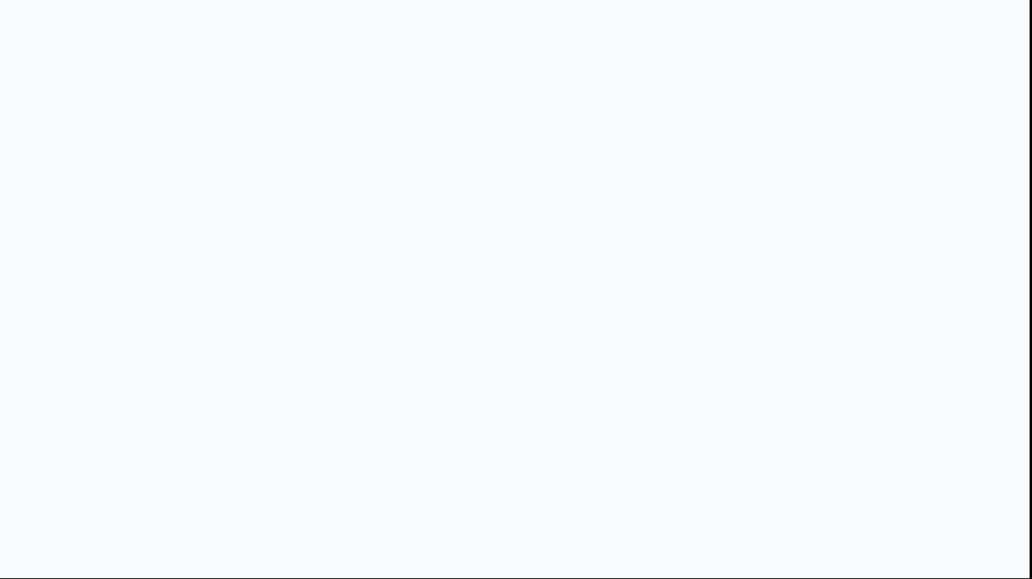
MOORE MACHINE AND STATE ENCODING
[ LOGIC_ARCHITECTURE ]
[ ENCODING_&_SAFETY ]
[ ] Moore Machine Logic: Output lights depend strictly on the current memory state.
[ ] State Encoding: 5 distinct phases represented by 3 binary bits (Q2, Q1, Q0).
[ ] System Stability: Ensures lights do not flicker or change based directly on asynchronous inputs.
[ ] Mathematical Safety: Boolean equations prevent "double green" errors.
[ SAFETY_EQUATION ] NS_G = !Q2 & !Q1 & !Q0 (S0) EW_G = !Q2 & Q1 & !Q0 (S2) Result: Mutual Exclusion
[ ] Predictable Transitions: State changes occur only on the rising edge of the clock.

Slide 6

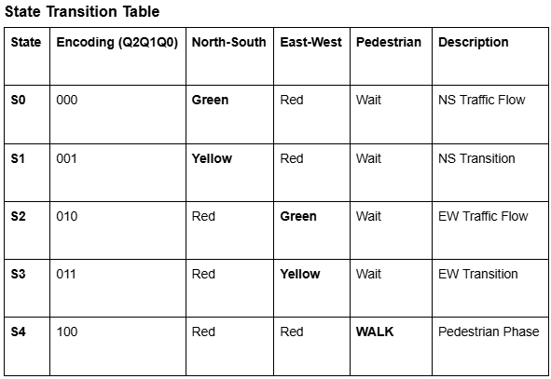
FSM STATE CYCLE
[ VEHICLE_PHASES ]
[ SPECIAL_PHASES ]
[ S0 ] North-South Green / East-West Red flow.
[ S4 ] Pedestrian Walk: Total Safety Stop. All vehicle lights are Red.
[ S1 ] North-South Yellow transition phase.
[ S2 ] East-West Green / North-South Red flow.
[ SMART_SKIPPING ]
[ S3 ] East-West Yellow transition phase.
[ ] System checks the latch at the end of S3.
[ ] If NO request exists: Skip S4 and return to S0.
[ ] If request exists: Proceed to S4.

Slide 7
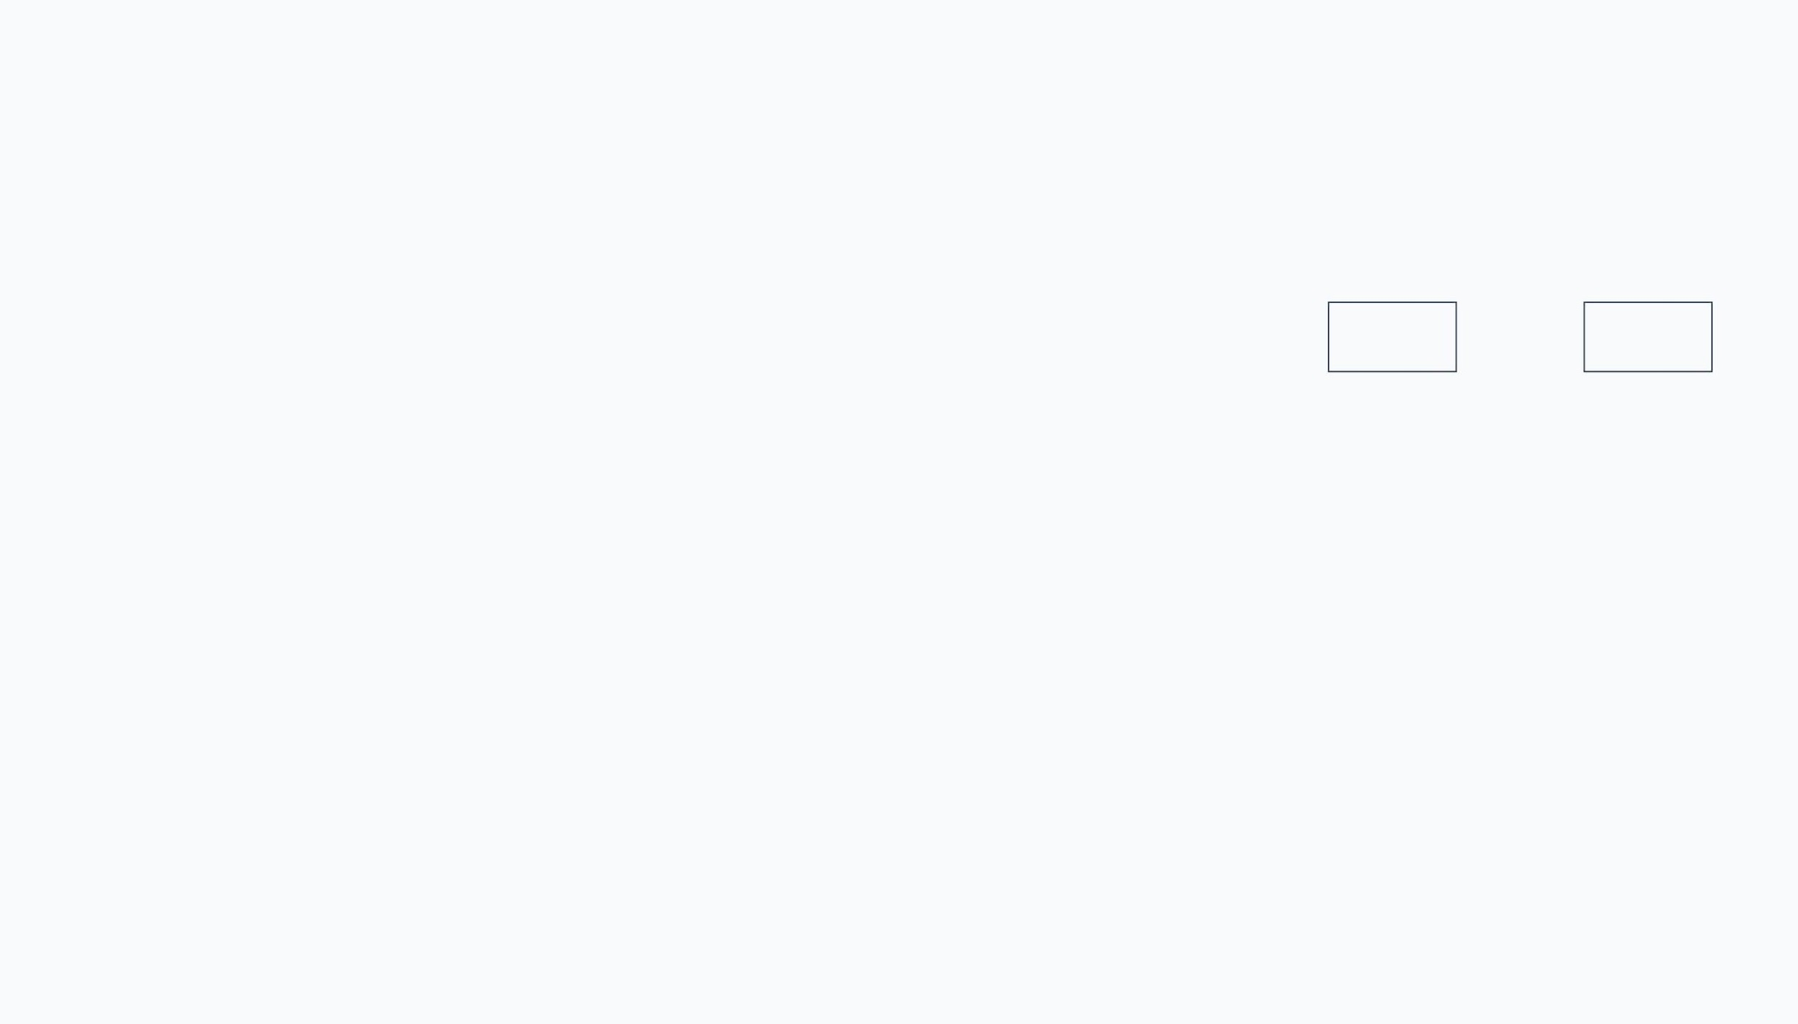
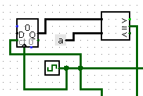
TIMING CONTROL SYSTEM
[ PHASE_REQUIREMENT ]
[ BINARY_PATTERN ]
Each main light phase must stay active for exactly 10 seconds (10 clock cycles).
Decimal 10 = Hex 'a'
C3
C2
C1
C0
1
0
1
0
[ COMPARATOR_FUNCTION ]
[ LOGIC ] T_Done = C3 & !C2 & C1 & !C0
Monitors counter signals (C3–C0) to trigger the T_Done transition.
[ AUTOMATIC_RESET ]
Counter "Maximum Value" set to 0xa to ensure 10-second cycle repeats.

Slide 8

ADVANCED PEDESTRIAN LATCH
[ PROBLEM_SOLVED ]
Prevents missing quick button presses from pedestrians who walk away. A simple button signal is too transient for a slow-cycling FSM.
[ MECHANISM: MEMORY_LOOP ]
Uses an OR gate and a D Flip-Flop to create a secure feedback loop. Once triggered, the signal "traps" itself in the high state.
[ FEEDBACK_LOOP ]
Keeps the request active even after the button is released. The FSM checks this latched signal at the end of the EW phase (S3).
[ AUTOMATIC_RESET ]
The S4 "Walk" state signal is used to clear the Flip-Flop, breaking the loop and resetting the memory for the next cycle.

Slide 9
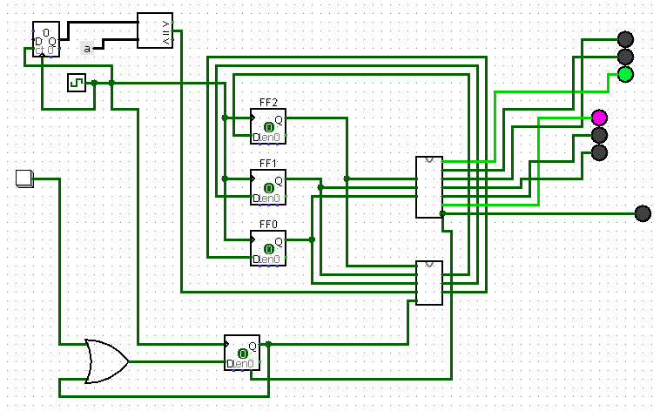
SYSTEM ARCHITECTURE (LOGISIM)
[ VISUAL_ORGANIZATION ]
Three clear sections: Timing Control (Left), FSM Memory (Middle), and Output LEDs (Right).
[ SYNCHRONIZATION ]
A single clock signal ensures all components stay synchronized across the schematic.
[ MODULARITY ]
Subcircuits for State Memory and Output Logic improve readability and debugging.
[ PEDESTRIAN_LINK ]
Button connects to the memory latch at the bottom of the main schematic.

Slide 10
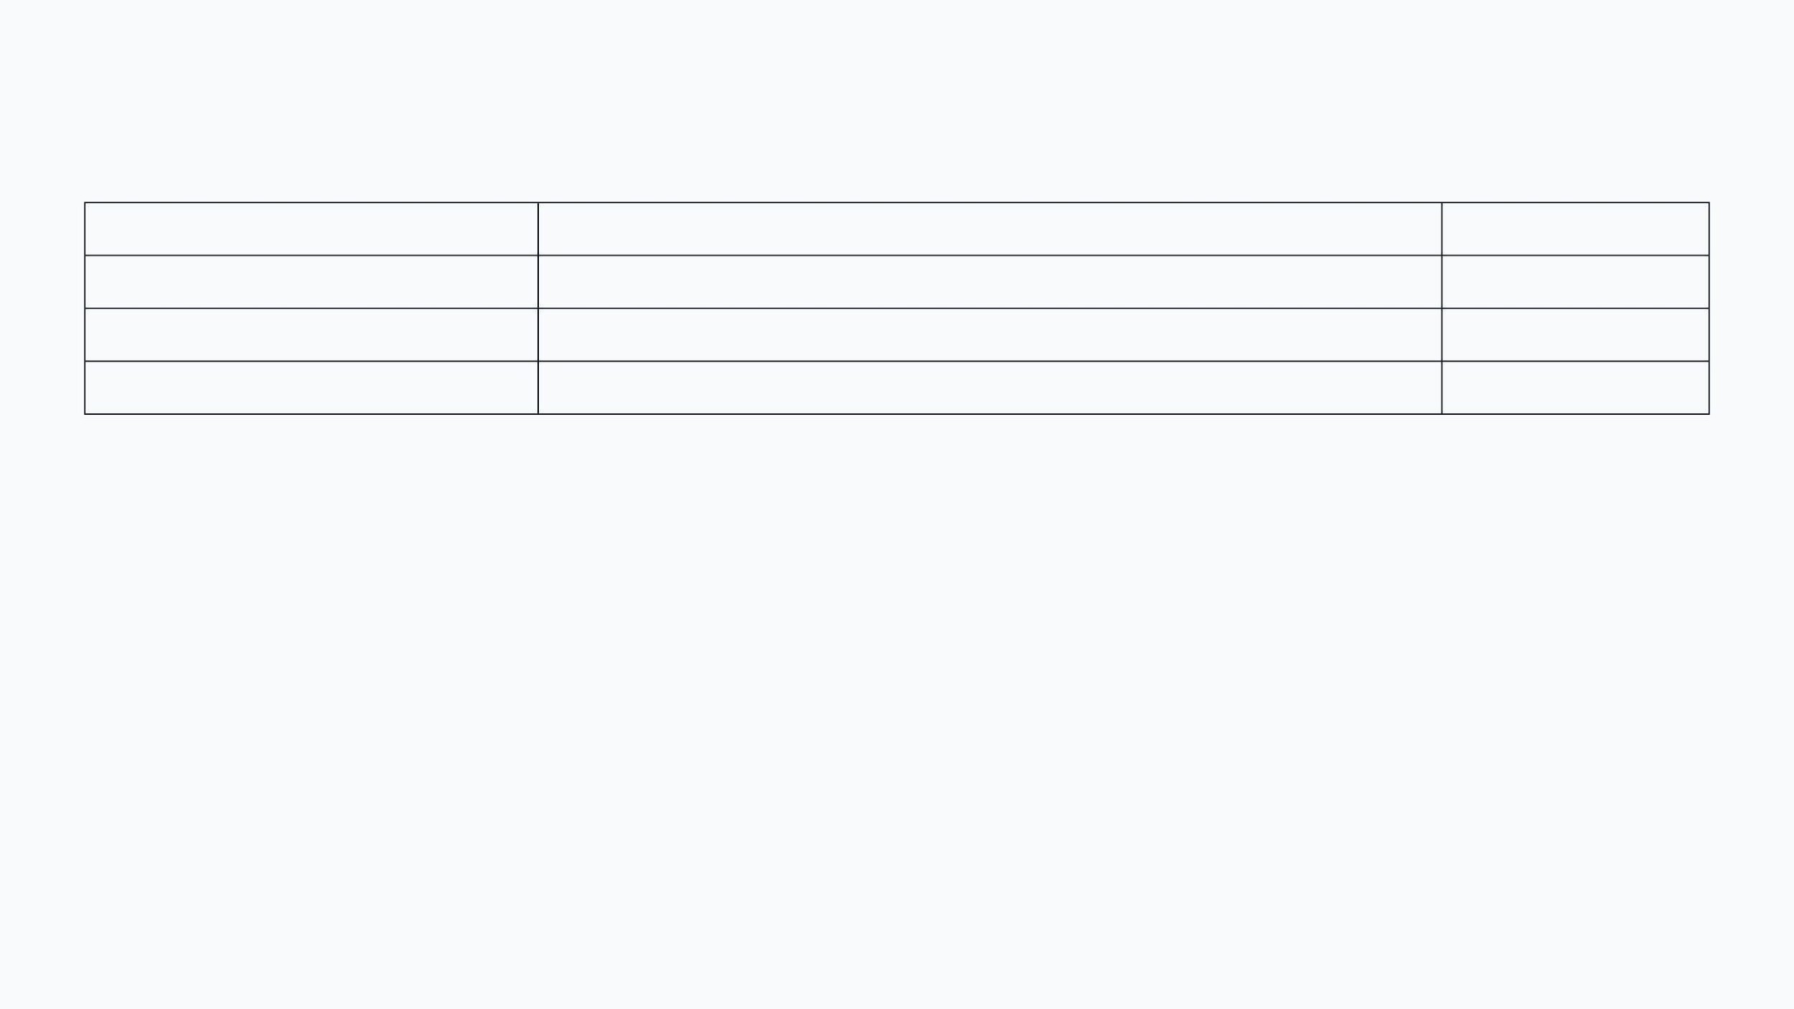
TESTING AND CONCLUSION
[ TEST_CASE ]
[ CONDITION ]
[ STATUS ]
Full Cycle
No Pedestrian: S0 -> S1 -> S2 -> S3 -> S0
PASSED
Timer Accuracy
S0 Active: Stays for exactly 10 ticks
PASSED
Pedestrian Priority
Button pressed in S0: Transitions to S4
PASSED
Latch Reset
During S4: Request clears after phase
PASSED
[ FINAL_REMARKS ]
[ ] Stable, safe, and robust engineering solution ready for simulation.
[ ] Successfully completed with high quality as a special dedication for Waleed’s birthday.
[ ] Demonstrates a deep understanding of digital logic and FSM design.

Slide 11

THANK YOU FOR ATTENTION!

